Slide 1
SOCIAL CONNECT & RESPONSIBILITIES

Slide 2
ORGANIC FARMING AND WASTE MANAGEMENT

Slide 3
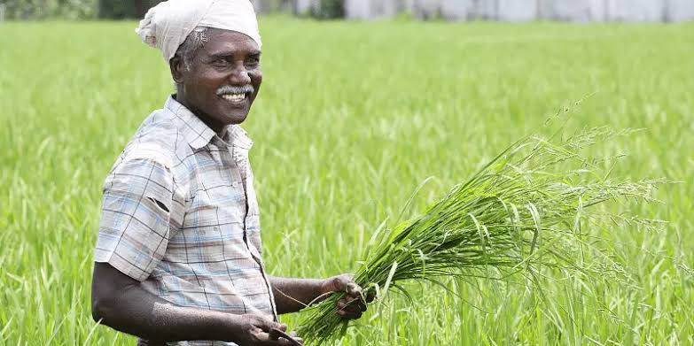
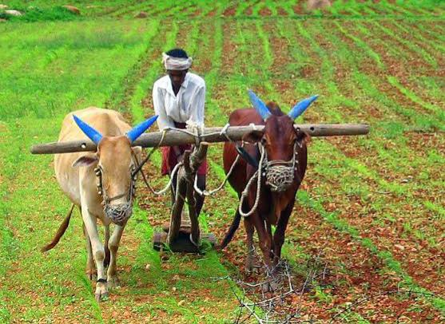
Organic Farming
An agricultural process that uses biological fertilisers and pest control acquired from animal or plant waste.

Slide 4
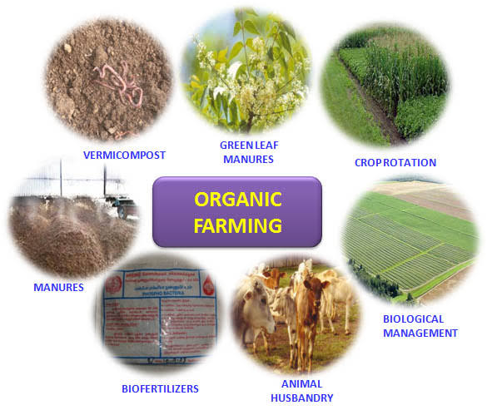
Organic farming

Slide 5
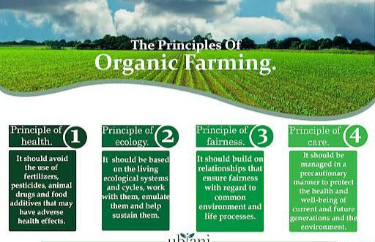

Slide 6
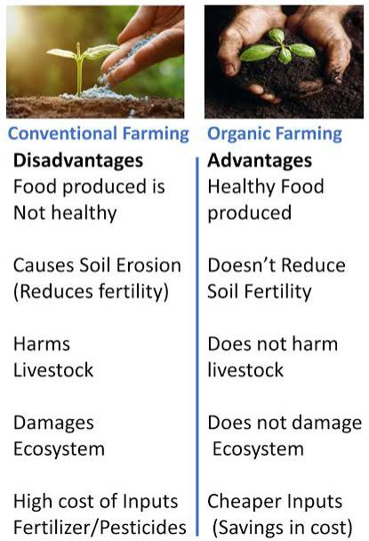
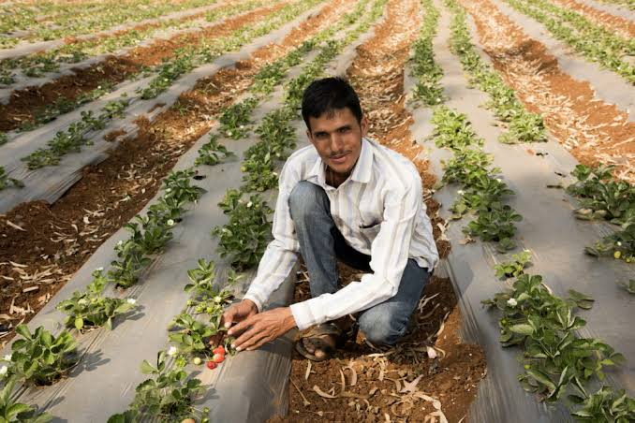
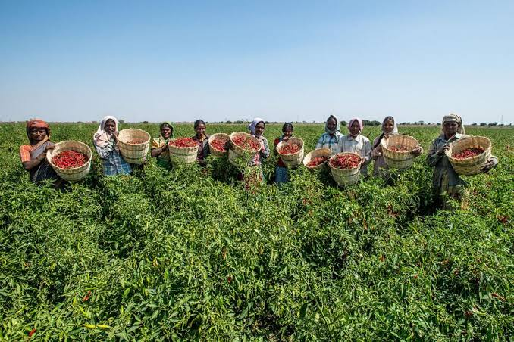

Slide 7
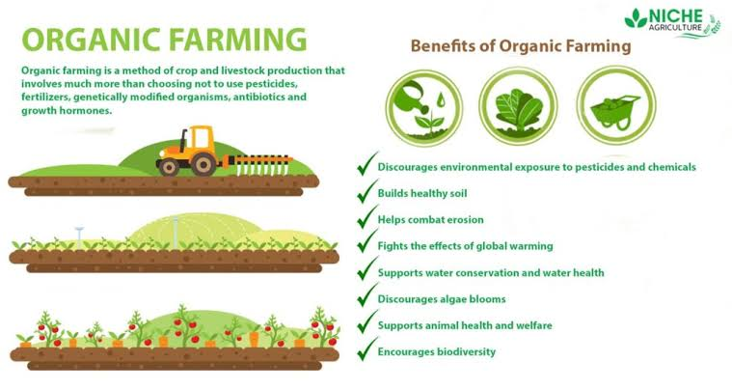

Slide 8
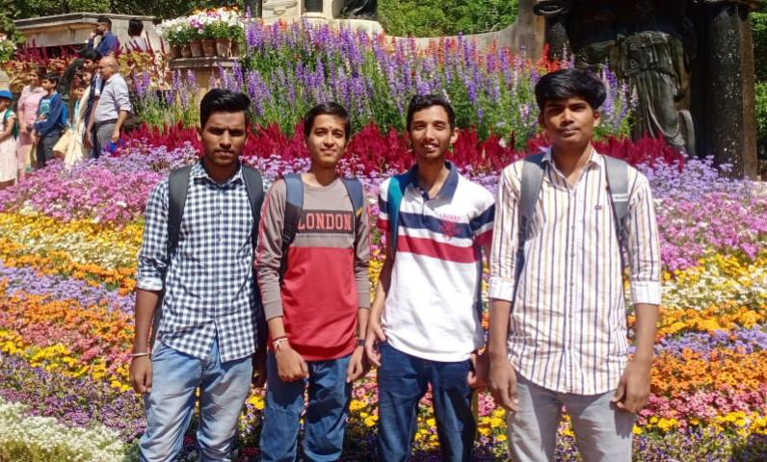
Genetically modified crops
Pest resistant
Maximize production
Low investment
Hybridised

Slide 9
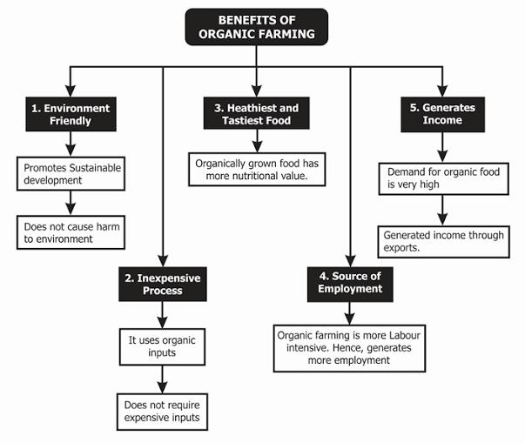

Slide 10
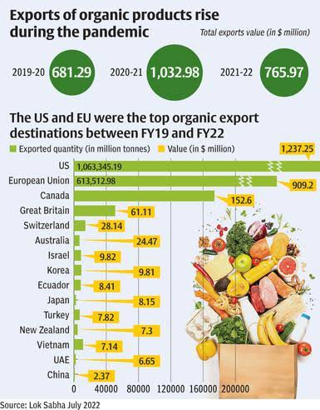
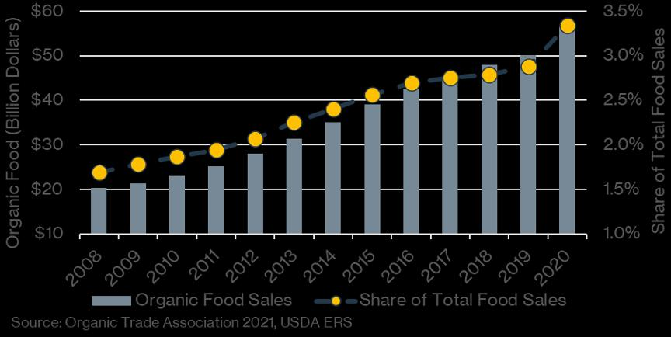
Demand for organic Farming

Slide 11
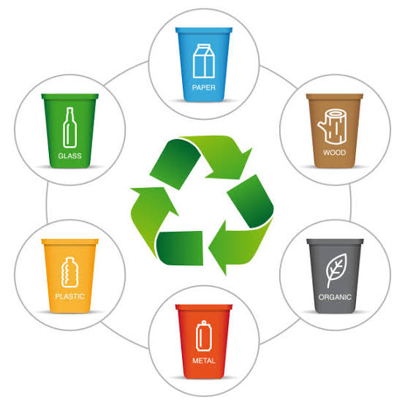
Waste Management
It includes the processes and actions required to manage waste from its inception to its final disposal.This includes the collection, transport, treatment and disposal of waste, together with monitoring and regulation of the waste management process and waste-related laws, technologies, economic mechanisms.

Slide 12
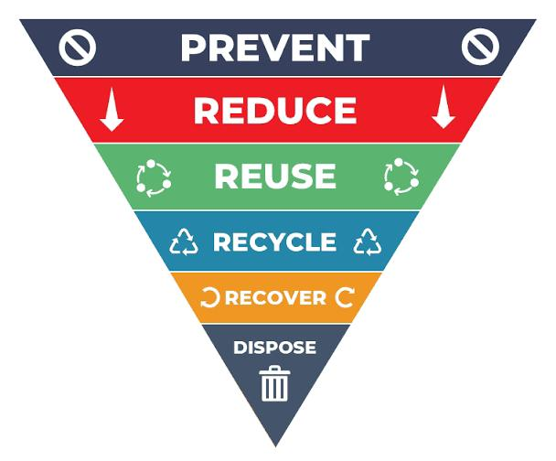
Effective way of waste management

Slide 13
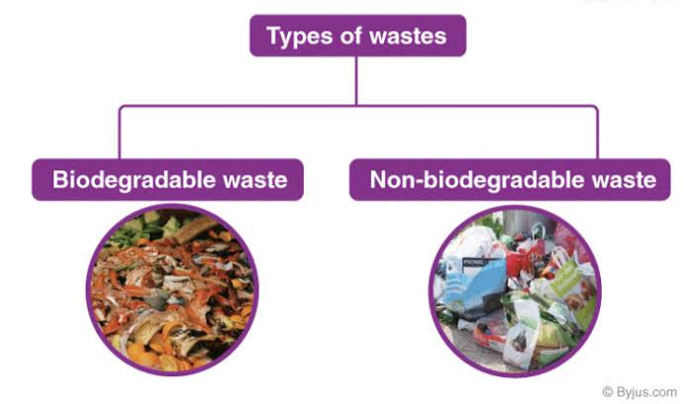

Slide 14
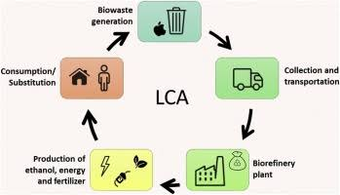

Slide 15
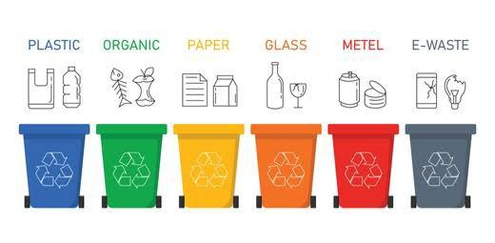

Slide 16
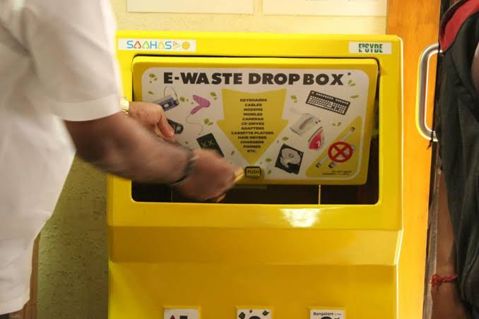
E- Waste Management

Slide 17

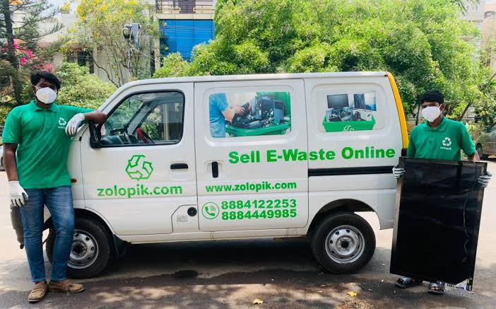
Now in banglore

Slide 18
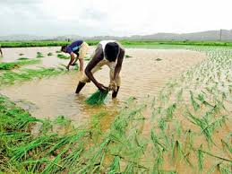
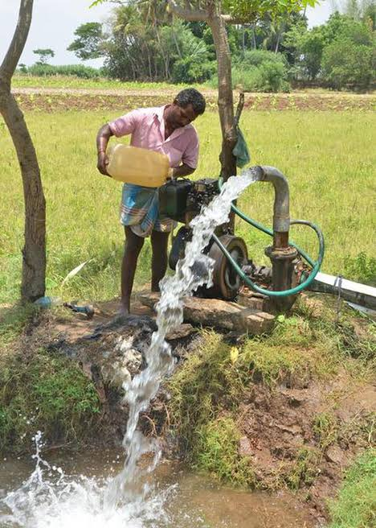
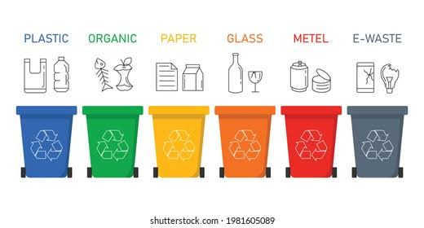
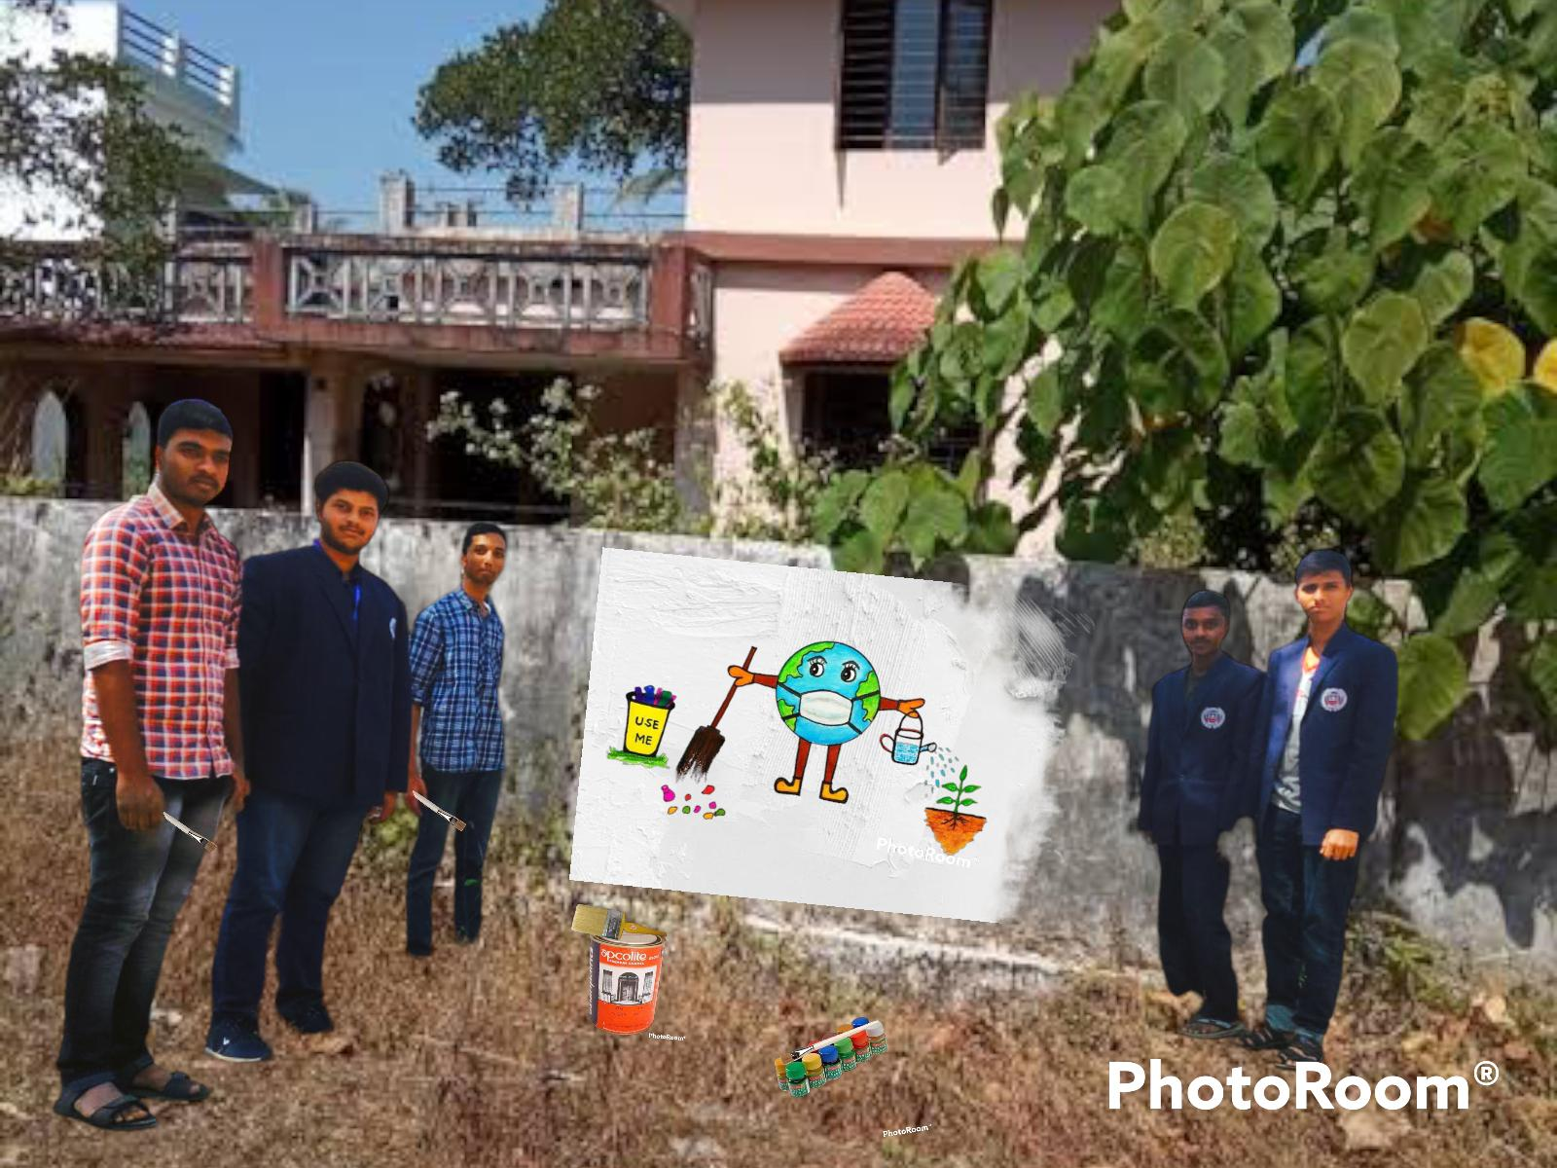
Thank you

